Slide 1
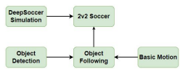
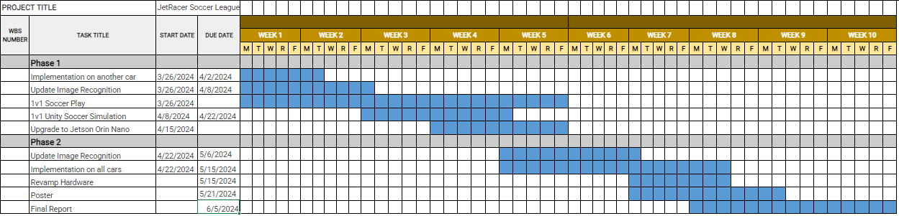
Overview
JetRacer Soccer Jarod Marshel, Casey Rittenhouse, Arjun Simha, Mason Kang, K Gupta, Julie Ham, Cooper Ritter
Overall Concept:
Overall Project Deliverable | Progress
Basic Movement | Done
Image recognition | Done
New sensor implementation | Done
Object following/Ball Striking | Done
Versus and Strategy | In progress
Github with documentation | In progress
Summary and report | In progress
New Sensor
Project is On Schedule
Gantt Chart/Schedule

Slide 2
Short-Term
JetRacer Soccer Jarod Marshel, Casey Rittenhouse, Arjun Simha, Mason Kang, K Gupta, Julie Ham, Cooper Ritter
Previous Meeting Action Items:
Item | Description | Owner | Target Date | Status
1 | Build field for cars | Jarod | Feb 19 | Done
2 | Unity soccer simulation training | Mason | Jan 31 | Done
3 | Object following | Everyone | Mar 8 | Done
4 | Implement new sensor onto car | Everyone | Mar 11 | Done
5 | Preliminary Design Review | Everyone | Mar 12 | Done
6 | Retrain Object Detection | CV team | April 15 | Done
7 | 1v1 Soccer | Everyone | May 15 | In Progress
Biweekly Action Items:
Item | Description | Owner | Target Date | Status
1
2 | 1v1 Soccer Logic | Strategy Team | May 13 | In Progress
3 | Set up software on cars | ROS Team | May 15 | Done
4 | Upload ZED SDK and new weights to both cars | CV team | May 11 | Done
5
Significant Roadblocks/ Non-developing Items:
Budget:
Total Proposed | Plan to Date | Used to Date | Used Vs Plan
$3500 USD | $1450 USD | $650 USD | +$1400 USD
Short Term Schedule:
Request for teaching staff:
May |  |  |  |  |  |  |  |  |  | Feb
6 |  |  |  |  | 11 |  |  |  |  | 16
Finish Poster
Update dataset
Finish implementing ball following onto car

Slide 3
Team Progress

Slide 4
ROS/Hardware (Cooper and Arjun)
JetRacer Soccer Jarod Marshel, Casey Rittenhouse, Arjun Simha, Mason Kang, K Gupta, Julie Ham, Cooper Ritter
Previous Work:
Created strategy, search, and strike files from FSM
Begun testing striking
Future Work:
Implement new dataset once completed
Defense
Improve reliability/accuracy

Slide 5
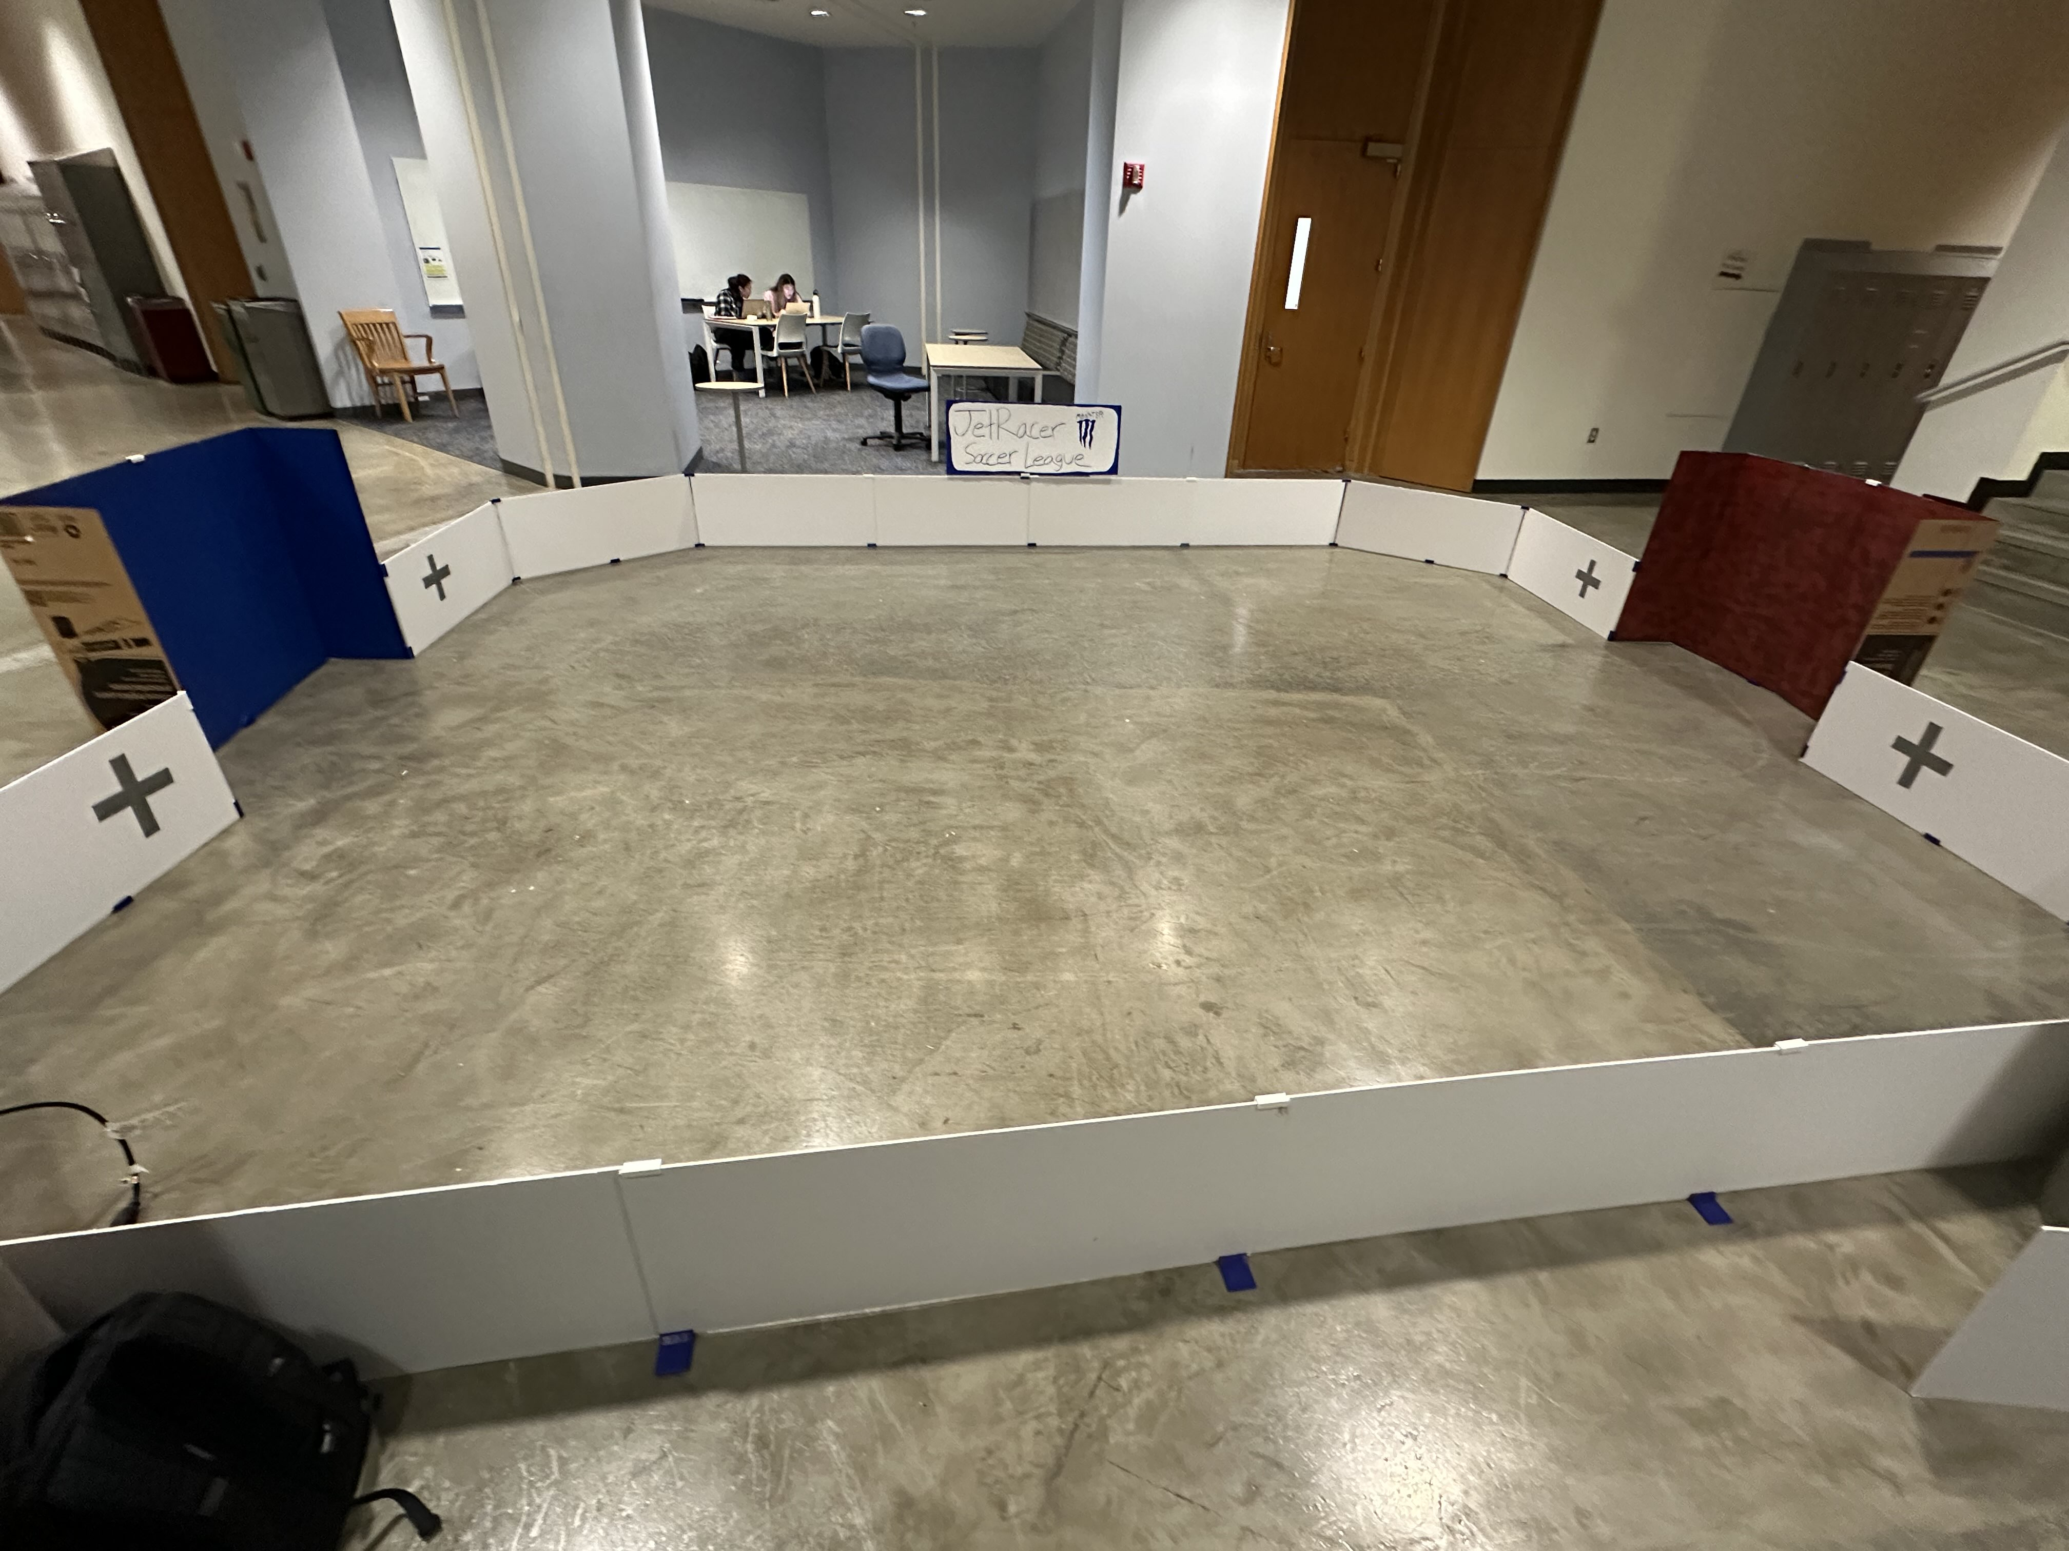
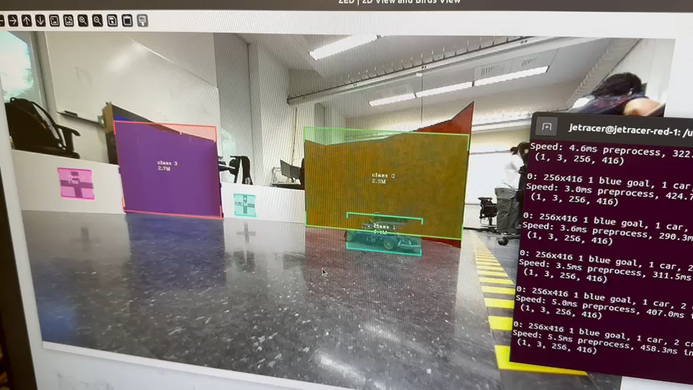
CV/Image Recognition (K and Julie and Jarod)
JetRacer Soccer Jarod Marshel, Casey Rittenhouse, Arjun Simha, Mason Kang, K Gupta, Julie Ham, Cooper Ritter
Previous Work:
Updated dataset and uploaded trained weights onto cars
Added marks next to goals to help with strategy
No "white wall" annotations
Label both cars as "car"
Future Work:
Reimplement ball following

Slide 6
Software/Strategy (Casey and Mason)
JetRacer Soccer Jarod Marshel, Casey Rittenhouse, Arjun Simha, Mason Kang, K Gupta, Julie Ham, Cooper Ritter
Previous Work:
Completed 180-degree turn
Created strategy file to control current state
Future Work:
Create offset file to avoid manually tuning movement values
Continue to implement strategy topic
Implement defensive strategy
Add interrupt to avoid collision

Slide 7
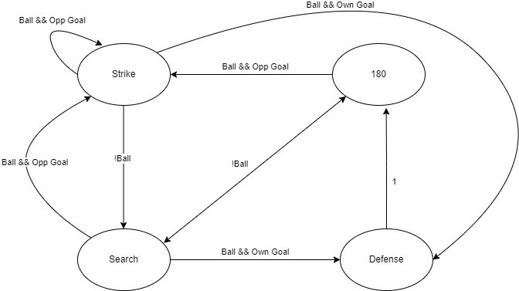
Strategy FSM

Slide 8
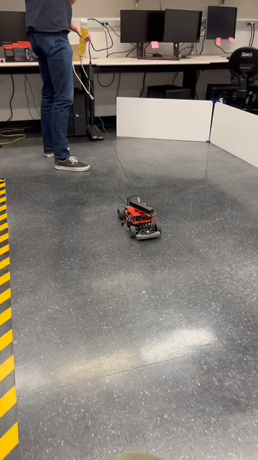
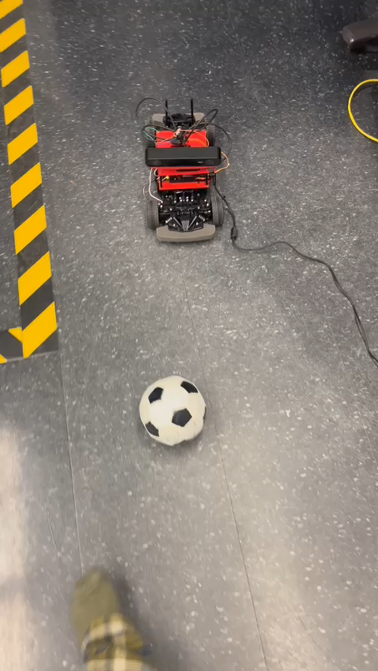
180-degree turn/ Ball Striking

Slide 9
Team Roles
Project Manager - Jarod
Point of Contact - Arjun
Budget Manager - Casey
ROS/Hardware Team:
Cooper, Arjun,
CV/Image Recognition Team:
K, Julie, Jarod
Software/Strategy Team:
Casey, Mason

Slide 10
Previous Year's Work
Built and gained full range of motion of 4 JetRacers using software
Set up a simulation environment to virtually train the agents
Structured a reward system for the reinforcement learning model
Implemented object detection model that identifies a soccer ball, opponent, and goal
Implemented software to follow and strike a ball
Developed logic process for striking a ball into a goal
Simulation results with reward structure demonstrate that agents can be trained to efficiently compete in a 2v2 soccer match
Created a GitHub page documenting the hardware and software instructions to setup JetRacers, a summary of the work completed, and plans for future work

Slide 11
Our Final Deliverables
Demonstrate basic motion of JetRacer: 01/2024
Demonstrate JetRacer Image Recognition for soccer play: 01/2024
Trade study of possible sensor additions: 02/2024
Preliminary Design Review: 02/2024
Showcase vehicle scoring soccer ball in the goal in real-world: 03/2024
Add additional agents in the real world: 04/2024
Final Data Review: 05/2024

